Slide 1
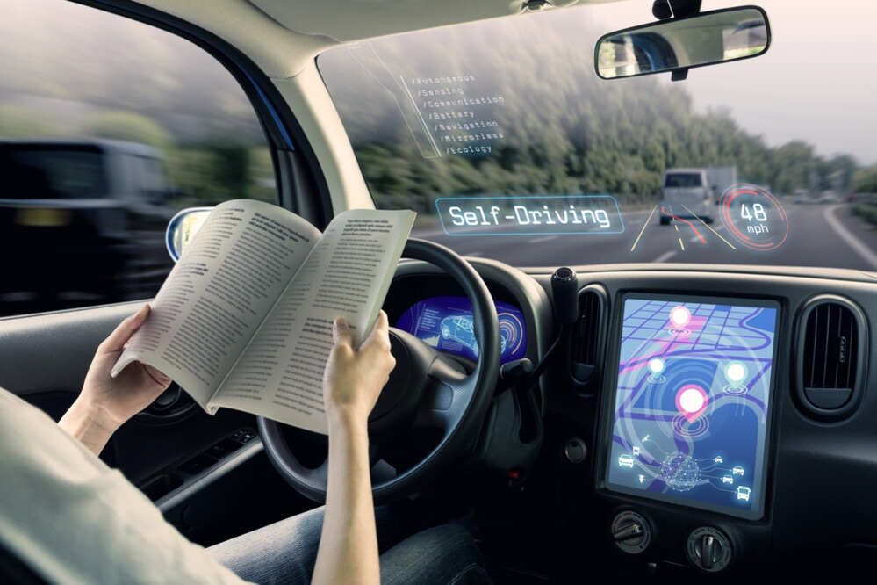
Collision Avoidance Systems Using
Reinforcement Learning Algorithms

Slide 2

ABOUT ME
Maurizio
Vassallo
Italy
Turin – Master in
Data Science and Engineering

Slide 3

AUTONOMOUS VEHICLES

Slide 4
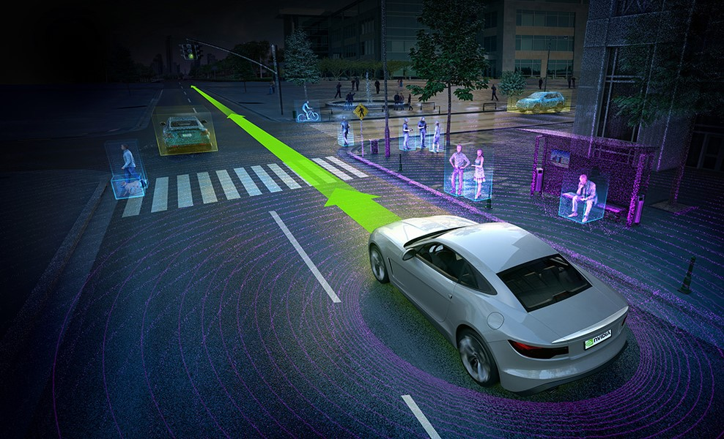
Autonomous Vehicles
Driving with no human intervention
Fulfil all mobility needs by 2040s and 2060s
AVs will generate a $7 trillion annual revenue stream by 2050
https://www.vtpi.org/avip.pdf
https://www.cnbc.com/2017/06/01/the-7-trillion-promise-of-self-driving-vehicles.html
Notes:
https://www.vtpi.org/avip.pdf
https://www.cnbc.com/2017/06/01/the-7-trillion-promise-of-self-driving-vehicles.html

Slide 5
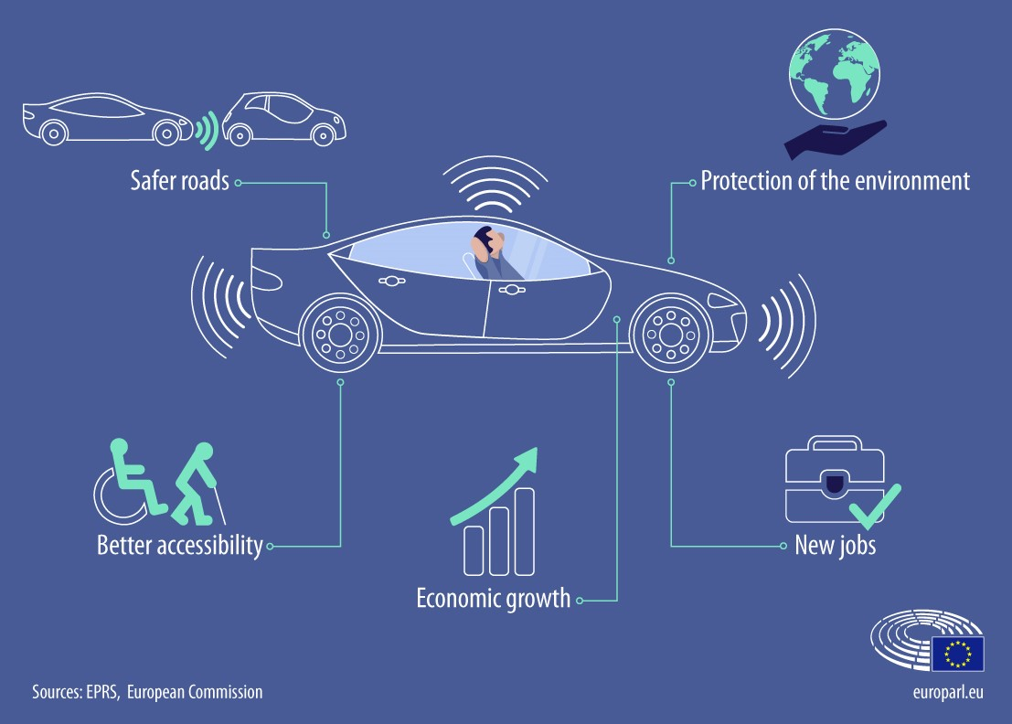
Autonomous Vehicles
Transportation Safety
Access to Transportation
Traffic Congestion and Land usage
Energy and Emissions
https://scholarship.law.upenn.edu/cgi/viewcontent.cgi?article=1048&context=jlpa
Notes:
https://scholarship.law.upenn.edu/cgi/viewcontent.cgi?article=1048&context=jlpa

Slide 6
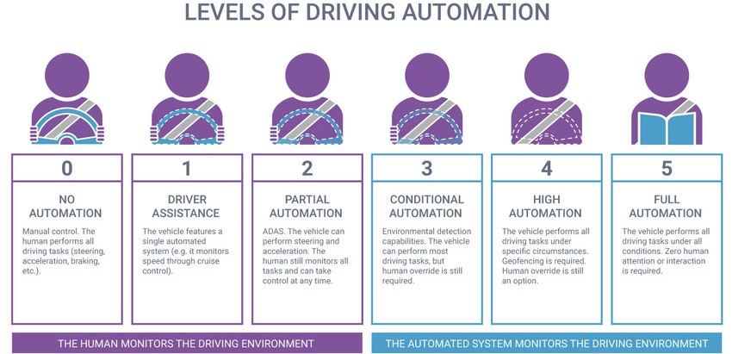
Autonomous Vehicles
https://www.synopsys.com/automotive/what-is-autonomous-car.html

Slide 7
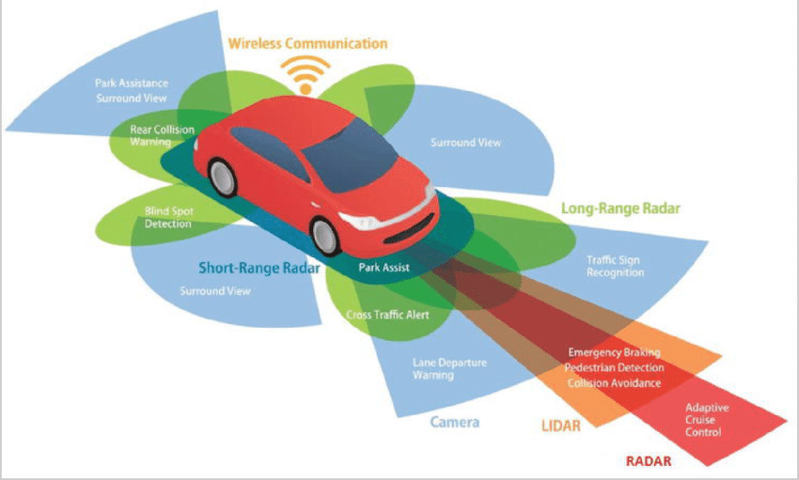
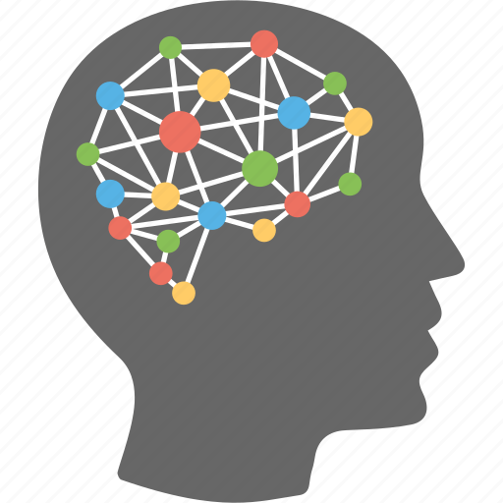
Autonomous Vehicles
https://www.researchgate.net/figure/Wireless-Communication-and-Sensors-in-Self-Driving-Cars_fig5_346527331
Notes:
https://www.researchgate.net/figure/Wireless-Communication-and-Sensors-in-Self-Driving-Cars_fig5_346527331

Slide 8
REINFORMCEMENT LEARNING

Slide 9
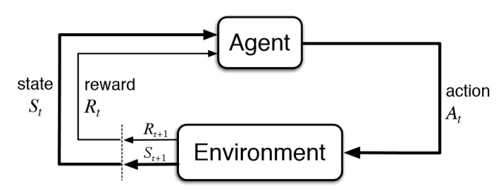
REINFORCEMENT LEARNING

Slide 10
REINFORCEMENT LEARNING
AGENT
ENVIRONMENT
STATE
ACTION
REWARD & REWARD FUNCTION
POLICY

Slide 11
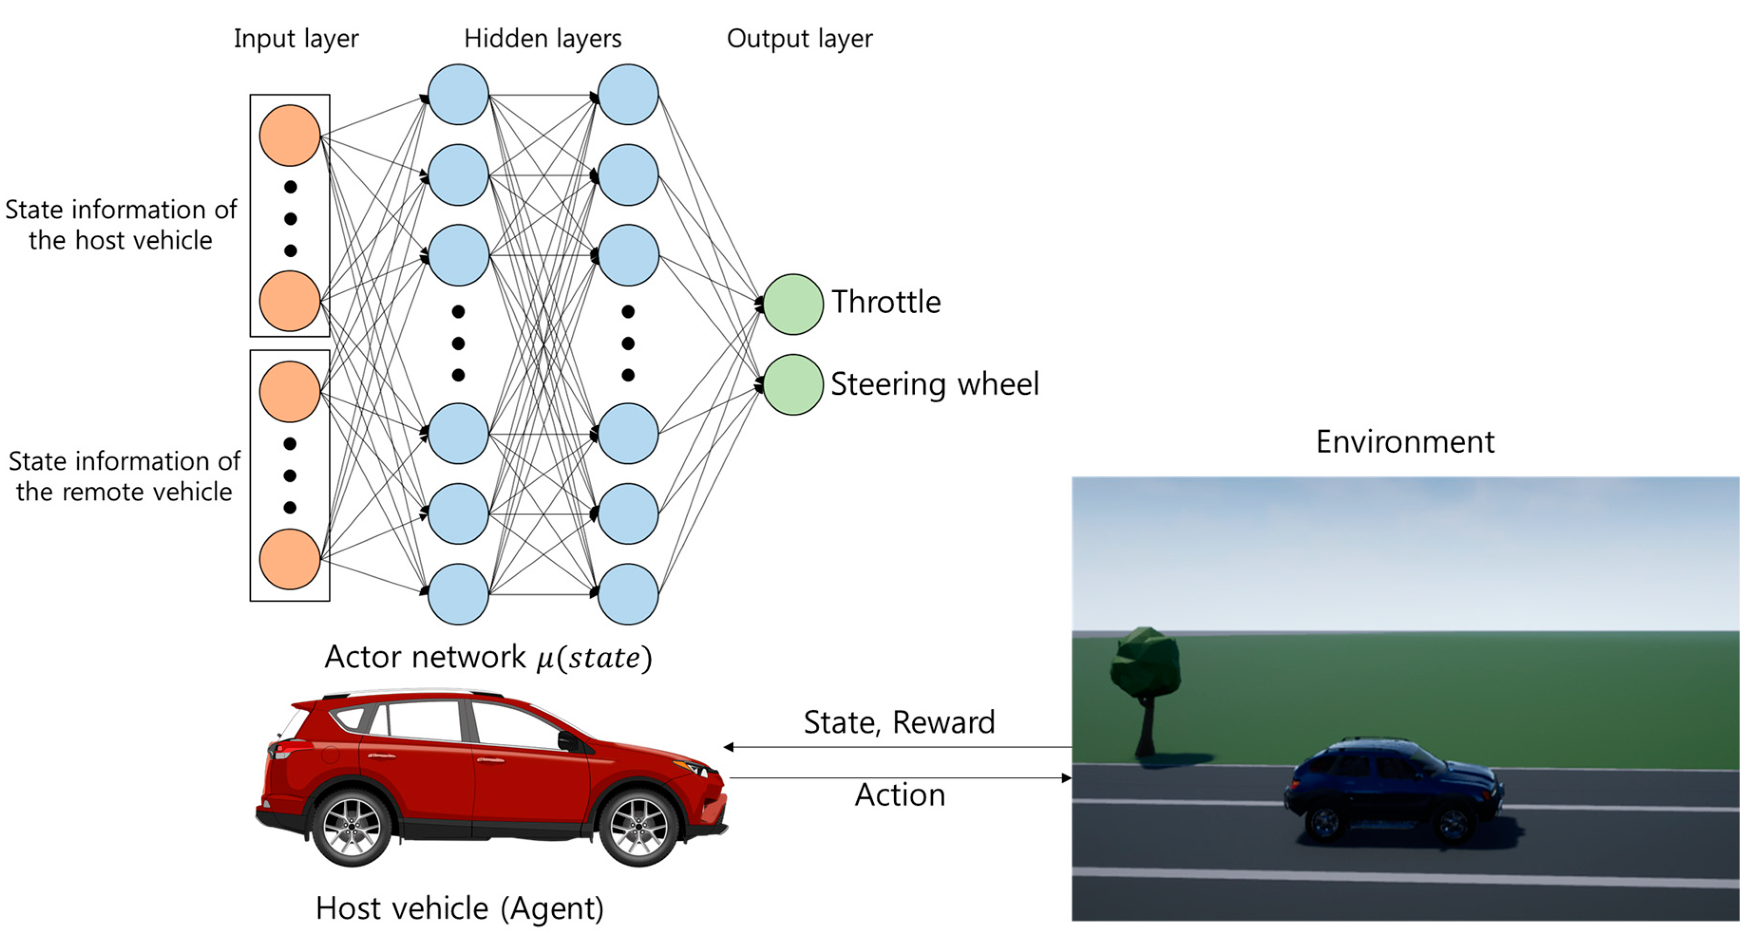
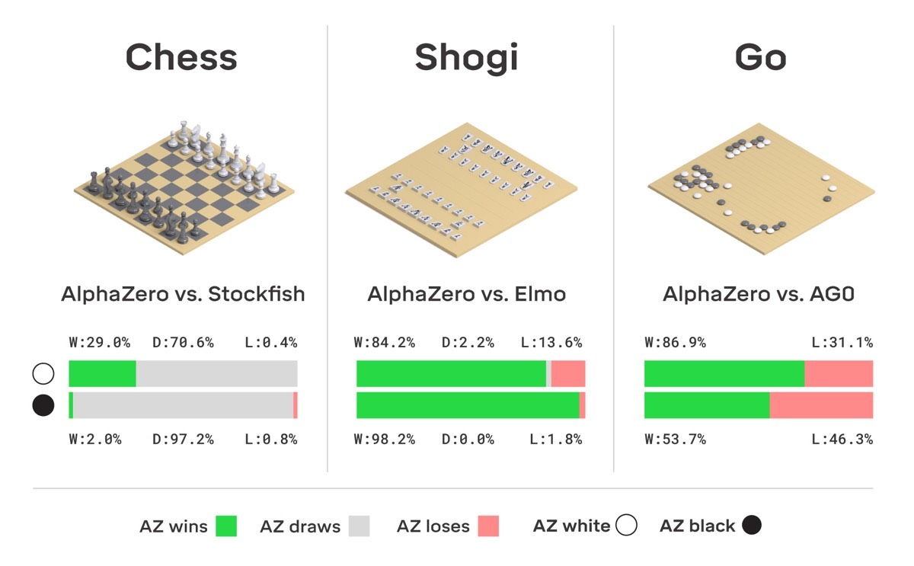
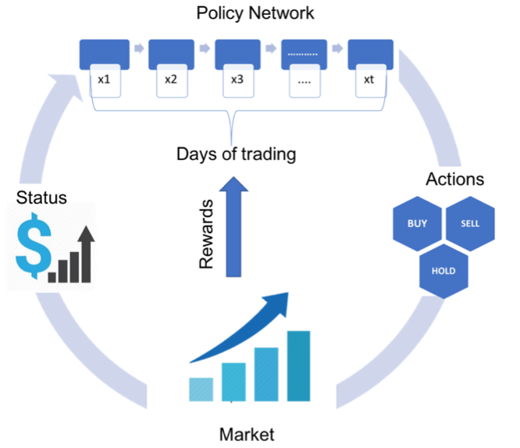
REINFORCEMENT LEARNING
SELF-DRIVING CARS
GAMES
FINANCE
https://www.mdpi.com/2079-9292/8/5/543
https://arstechnica.com/science/2018/12/move-over-alphago-alphazero-taught-itself-to-play-three-different-games/
https://medium.com/ibm-data-ai/reinforcement-learning-the-business-use-case-part-2-c175740999
https://arxiv.org/pdf/1908.06973.pdf
Notes:
https://www.mdpi.com/2079-9292/8/5/543
https://arstechnica.com/science/2018/12/move-over-alphago-alphazero-taught-itself-to-play-three-different-games/
https://medium.com/ibm-data-ai/reinforcement-learning-the-business-use-case-part-2-c175740999
https://arxiv.org/pdf/1908.06973.pdf

Slide 12
PROJECT IMPLEMENTATION

Slide 13




PROJECT IMPLEMENTATION
TOOLS
OBJECTIVES
  Build the environment, set up the actor, write the code
GOALS
  Train the models and test which one performs better

Slide 14
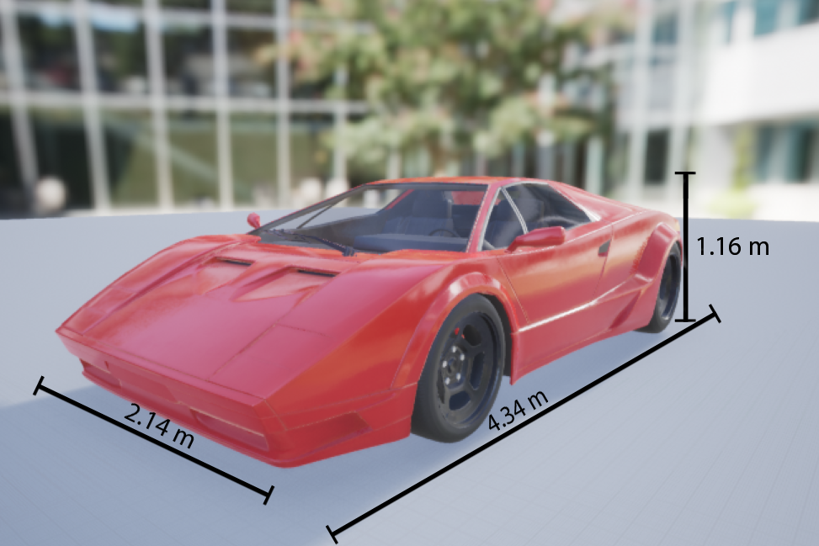
PROJECT IMPLEMENTATION
AGENT
ENVIRONMENT
STATE
ACTION
REWARD FUNCTION
POLICY

Slide 15
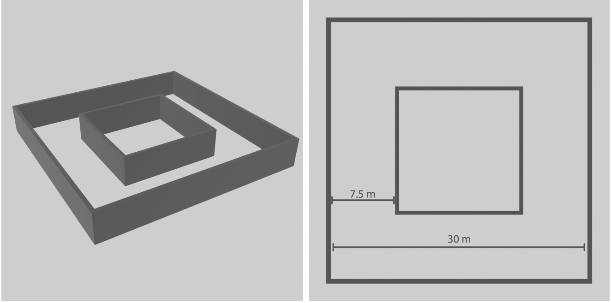
PROJECT IMPLEMENTATION
AGENT
ENVIRONMENT
STATE
ACTION
REWARD FUNCTION
POLICY
SIMPLE TRACK

Slide 16
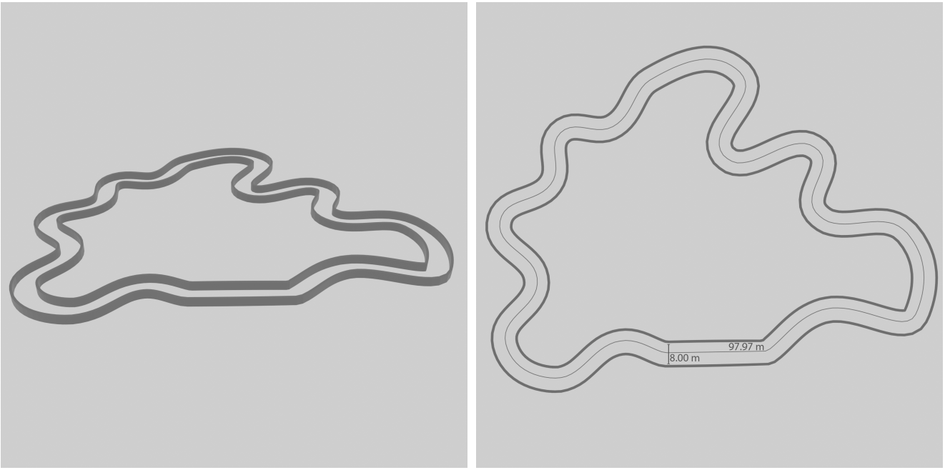
PROJECT IMPLEMENTATION
AGENT
ENVIRONMENT
STATE
ACTION
REWARD FUNCTION
POLICY
COMPLEX TRACK

Slide 17
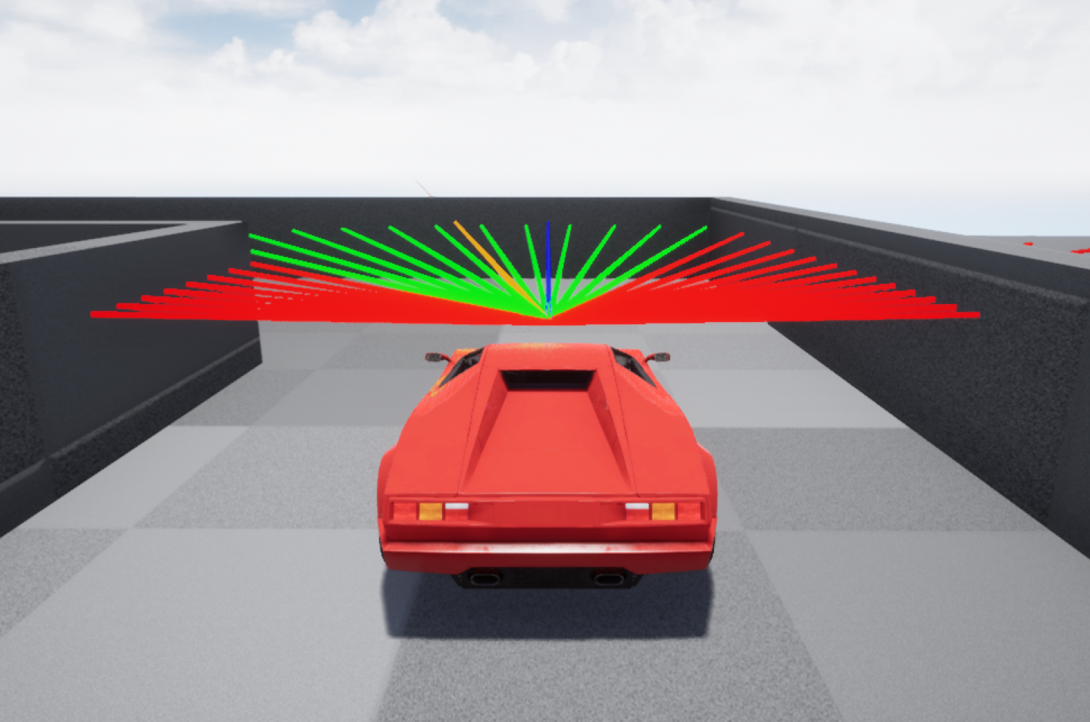
PROJECT IMPLEMENTATION
AGENT
ENVIRONMENT
STATE
ACTION
REWARD FUNCTION
POLICY
32 LIDAR SENSORS
170° ANGLE

Slide 18
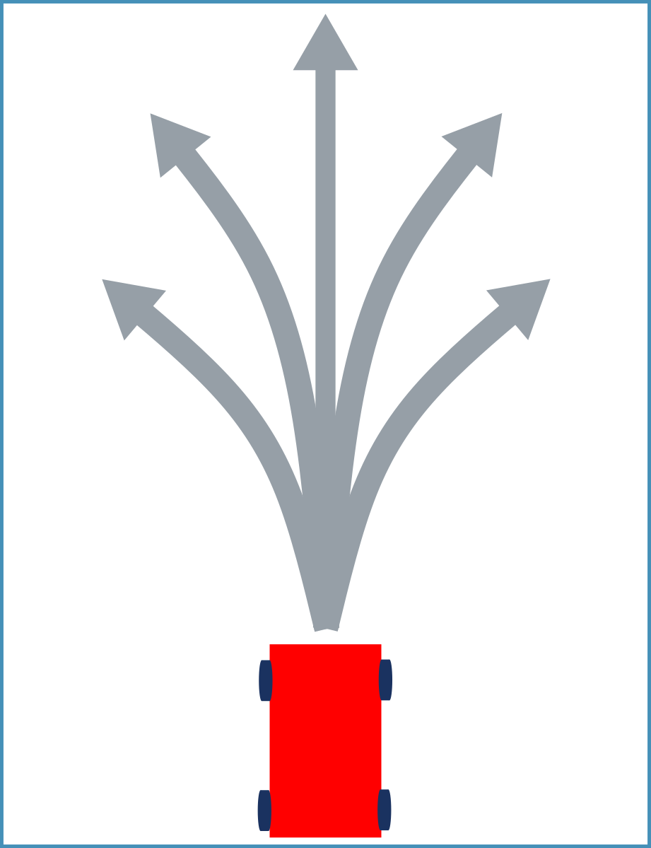
PROJECT IMPLEMENTATION
a₃
a₂ a₄
a₁ a₅
AGENT
ENVIRONMENT
STATE
ACTION
REWARD FUNCTION
POLICY
5 actions:
a₁: turn left,
a₂: turn slightly left,
a₃: full forward,
a₄: turn slightly right,
a₅: turn right.

Slide 19
ACTIONS
a₃
a₂ a₄
a₁ a₅
(THROTTLE, STEER ANGLE):
a₁ = (0.2,-45),
a₂ = (0.5,-22.5),
a₃ = (1,0),
a₄ = (0.5,22.5),
a₅ = (0.2,45).

Slide 20
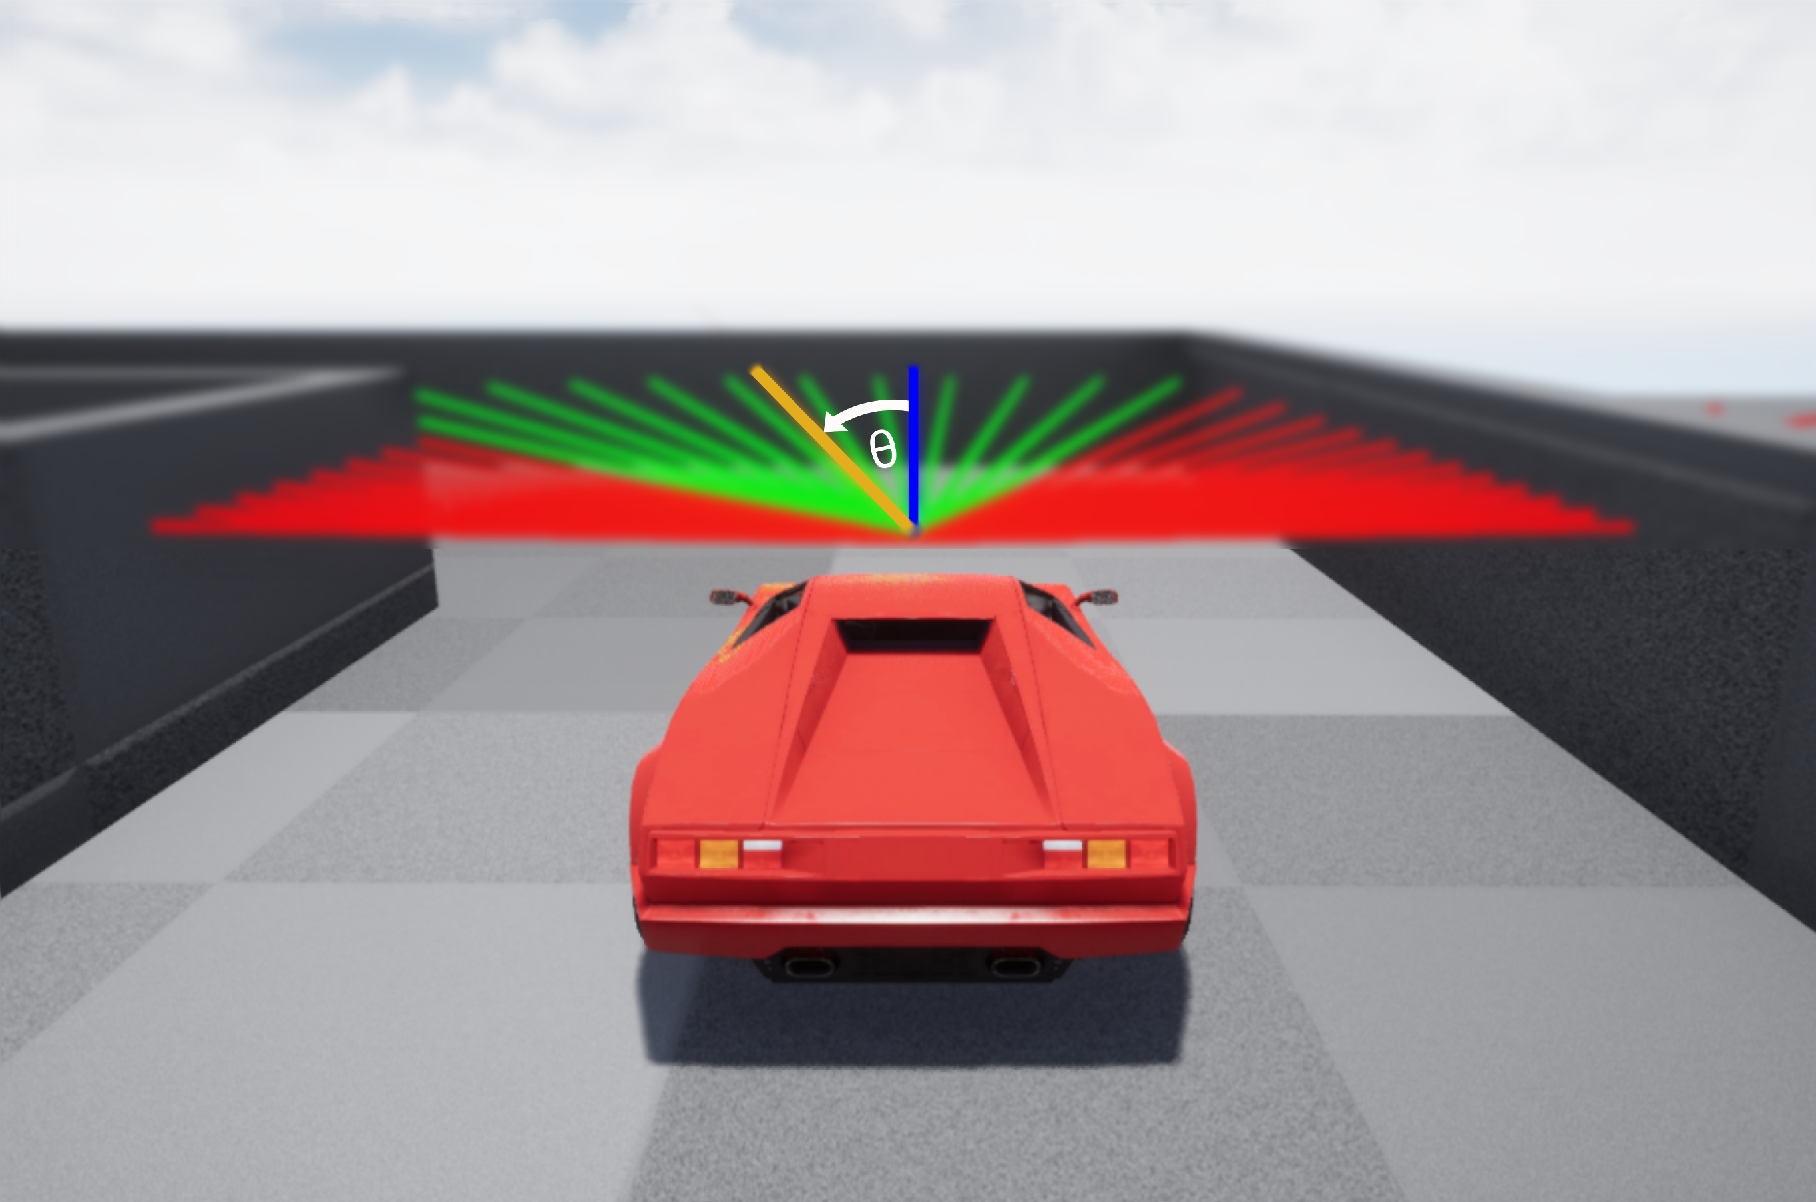
PROJECT IMPLEMENTATION
AGENT
ENVIRONMENT
STATE
ACTION
REWARD FUNCTION
POLICY

Slide 21
PROJECT IMPLEMENTATION
AGENT
ENVIRONMENT
STATE
ACTION
REWARD FUNCTION
POLICY
reward ∝ number green rays
reward ∝ speed

Slide 22
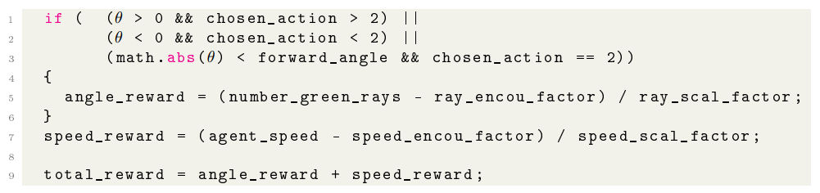
REWARD FUNCTION

Slide 23
PROJECT IMPLEMENTATION
AGENT
ENVIRONMENT
STATE
ACTION
REWARD FUNCTION
POLICY
How the agent chooses an action
2 main phases:
  Exploration
  Exploitation
  (Epsilon Greedy strategy)
3 main models tested:
  Deep Q-Network
  Double Deep Q-Network
  Dueling Double Deep Q-Network

Slide 24
PROJECT IMPLEMENTATION
Q-value: how ‘good’ is the actual state the agent is in
Loss: the difference of how ‘good’ is the current state w.r.t the next state
Reward: numeric value
Artificial Neural Network: collection of connected units or nodes called artificial neurons, which loosely model the neurons in a biological brain.

Slide 25
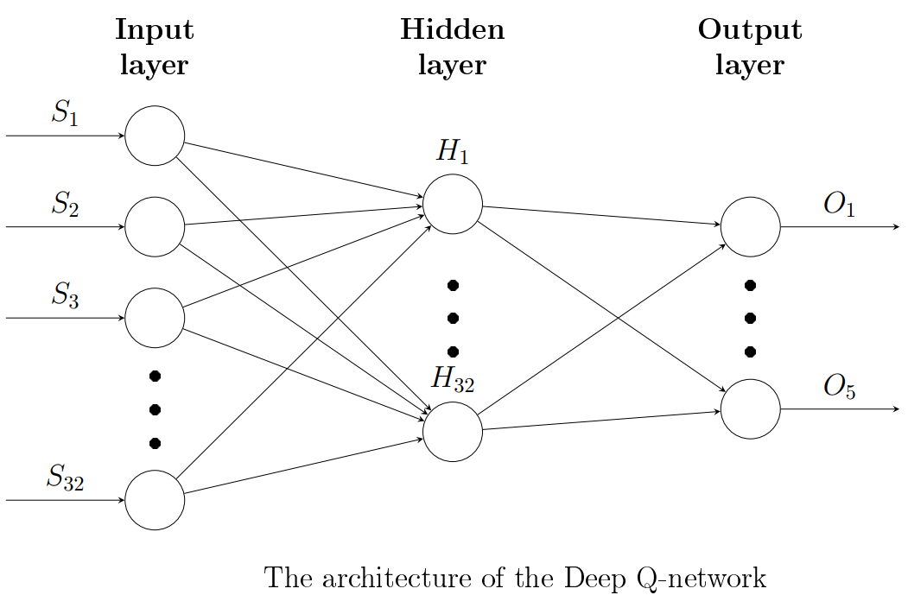
Policy:
Deep Q-Network
Loss = L[Q_{θ}(s) – target]
target = reward + Q*_{θ}(s’)
The Policy Network, Q_{θ}, is used to calculate both the current Q-value and the best next Q-value.

Slide 26


Policy
Deep Q-Network

Slide 27
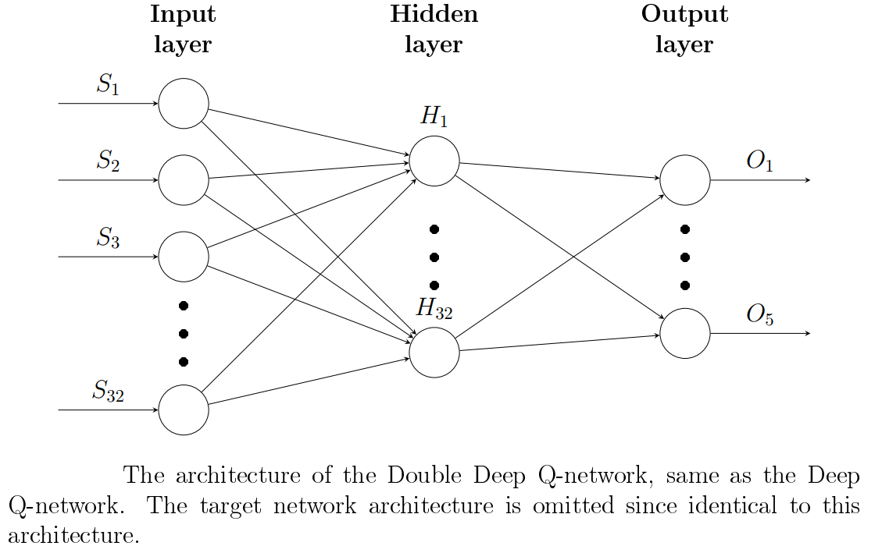
Policy:
Double Deep Q-Network
Loss = L[Q_{θ}(s) – target]
target = reward + Q*_{θ}-(s’)
The Policy Network, Q_{θ}, is used to calculate the current Q-value, while the best next Q-value is calculated using the Target Network, Q_{θ}-.

Slide 28



Policy:
Double Deep Q-Network
Network updates using Polyak averaging:

Slide 29
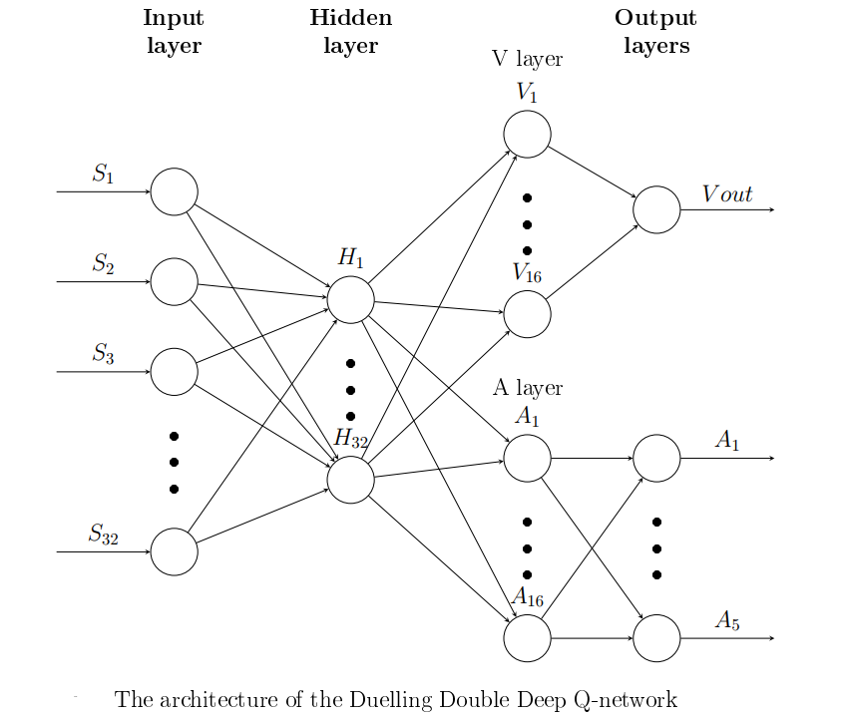
Policy:
Dueling Double Deep Q-Network
Advantage: relative measure of the importance of each action.
Loss = L[Q_{θ}(s) – target]
target = reward + Q*_{θ}-(s’)
The current Q-value and the best next Q-value are proportional to the Advantage value

Slide 30
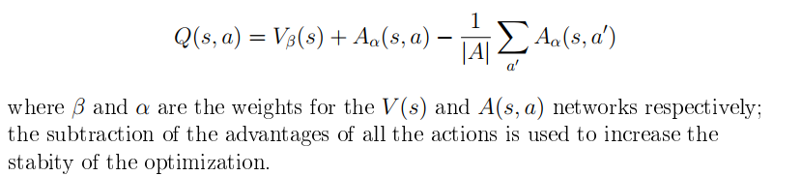
Policy:
Dueling Double Deep Q-Network
Advantage A(s, a) = Q(s,a) – V(s)
Q(s,a): value of choosing the action a in state s,
V(s): value of being in state s,
A(s,a): obtain a relative measure of the importance of each action.

Slide 31
results

Slide 32
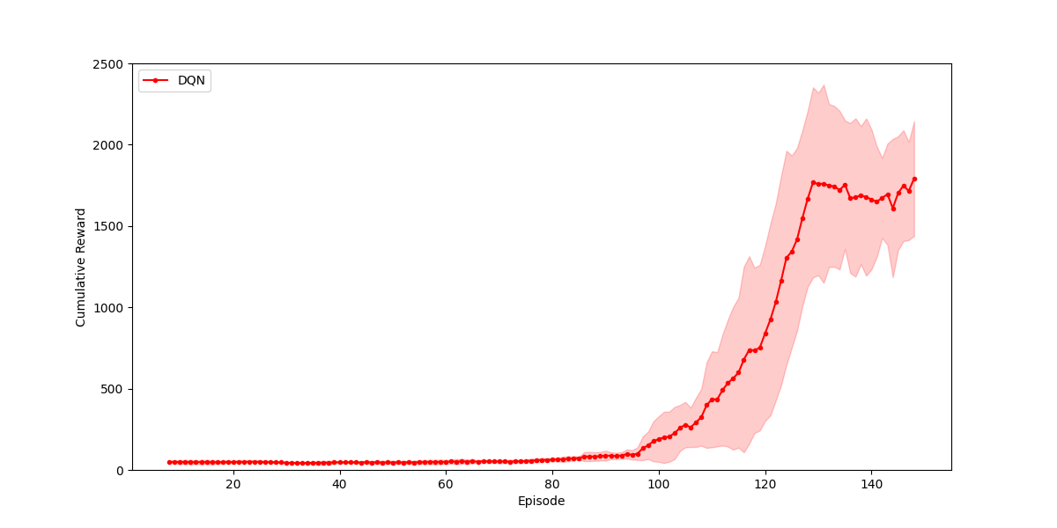
DEEP Q-NETWORK

Slide 33
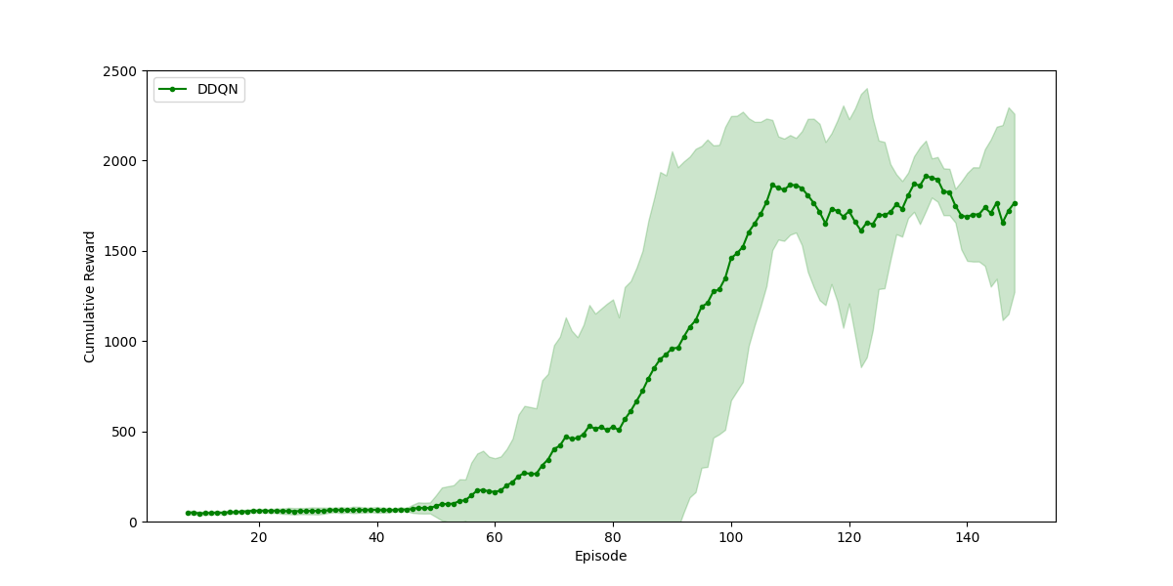
Double DEEP Q-NETWORK

Slide 34
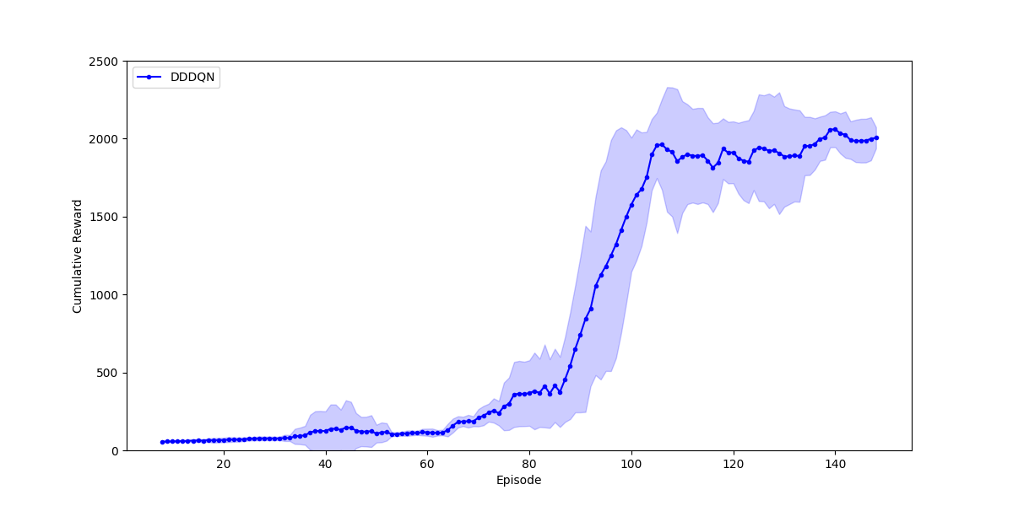
DUELLING Double DEEP Q-NETWORK

Slide 35
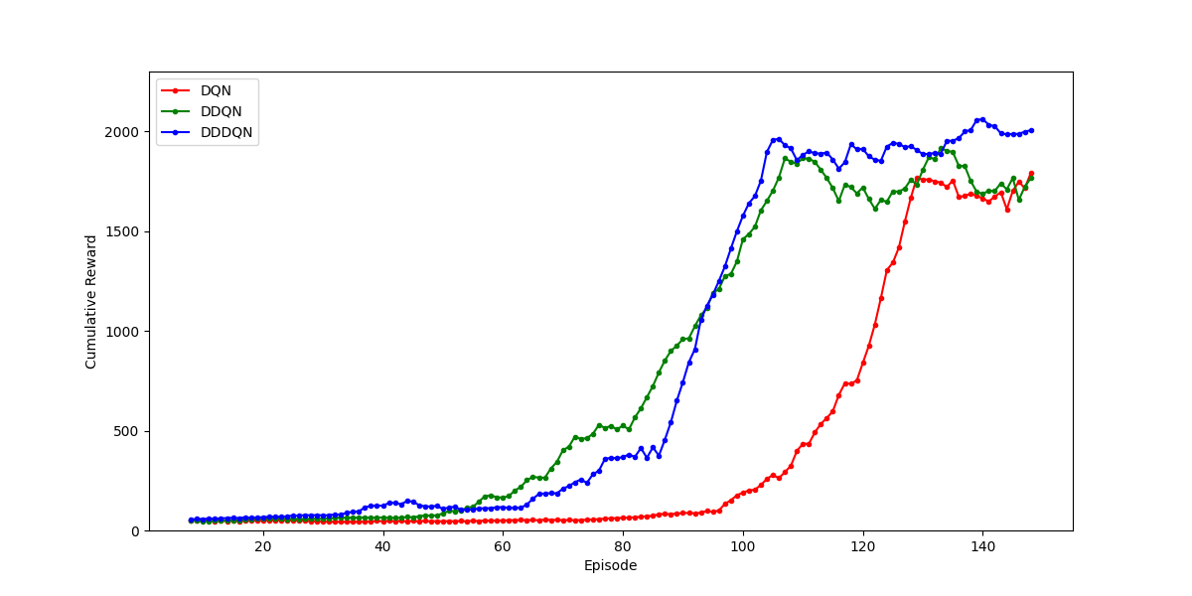
MODELS COMPARISON

Slide 36
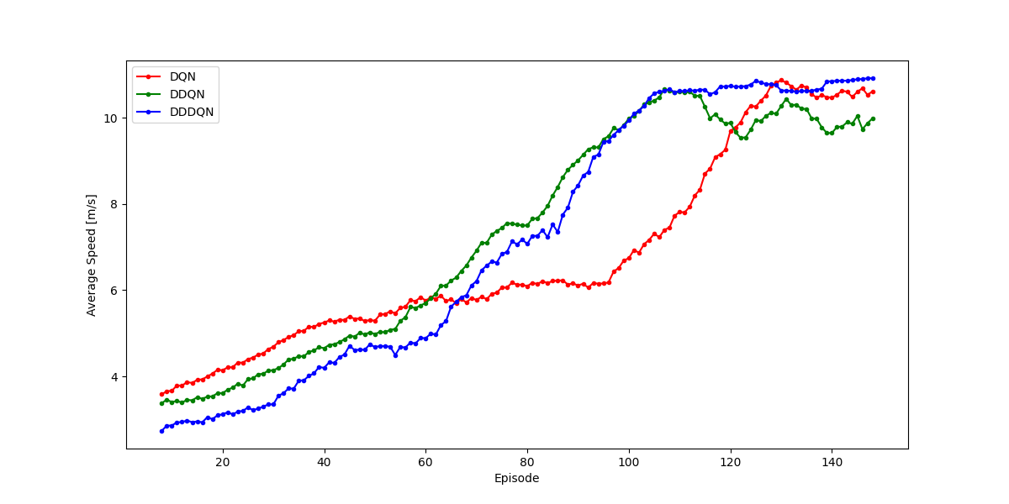
MODELS COMPARISON

Slide 37
MODELS COMPARISON
Model | Max Score | Improvement¹
DQN | 1791.5 | /
DDQN | 1915.1 | +6.90%
DDDQN | 2060.3 | +7.58%
¹ Improvement with respect to the previous model. These are calculated as follow:
improvement = (current_model_max − previous_model_max)/previous_model_max ∗ 100

Slide 38
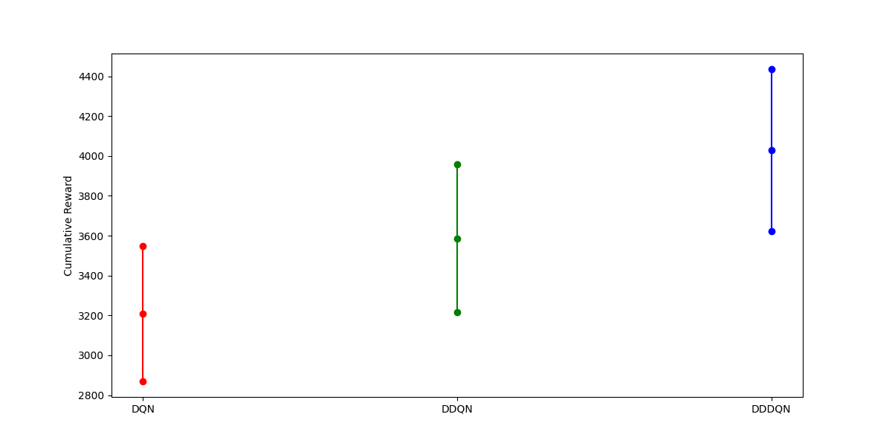
MODELS COMPARISON – COMPLEX TRACK

Slide 39
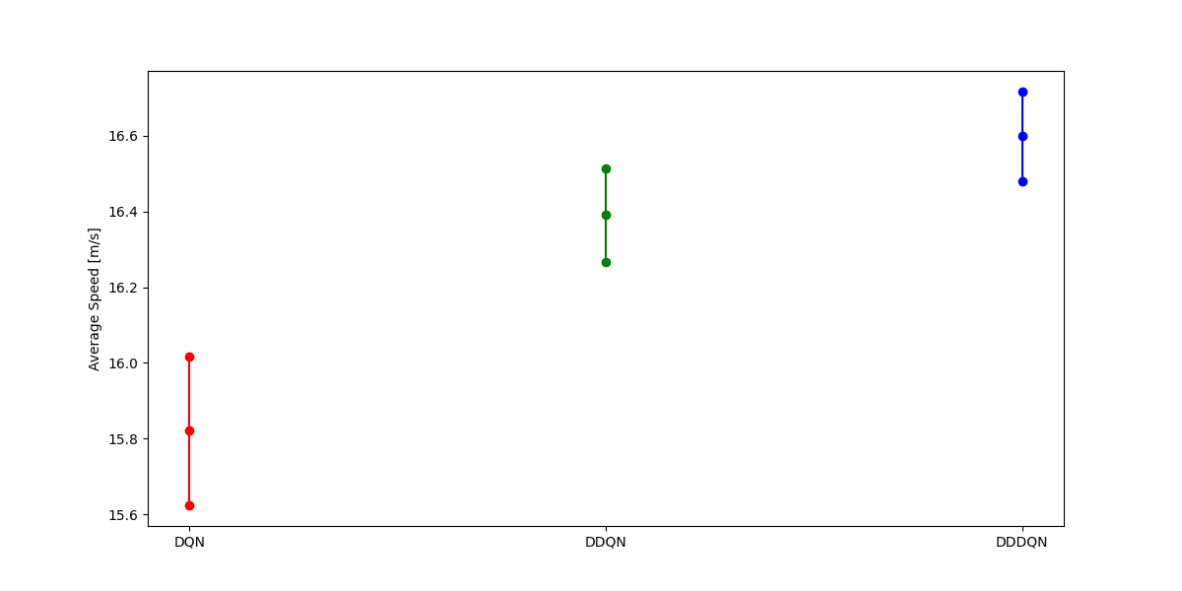
MODELS COMPARISON – COMPLEX TRACK

Slide 40
MODELS COMPARISON – COMPLEX TRACK
Model | Avg Score | Improvement¹
DQN | 3209.1 | /
DDQN | 3586.9 | +11.77%
DDDQN | 4029.4 | +12.33%
¹ Improvement with respect to the previous model. These are calculated as follow:
improvement = (current_model_max − previous_model_max)/previous_model_max ∗ 100

Slide 41
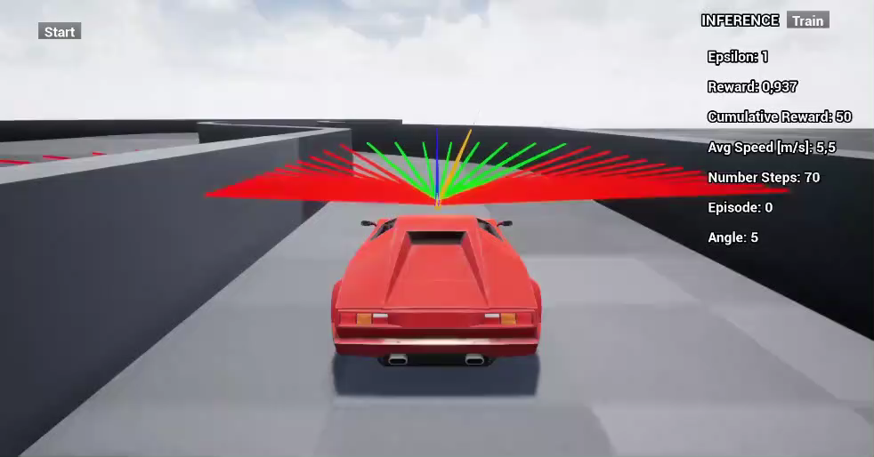

Slide 42
FUTURE WORKS

Slide 43
Future Works
Find better hyper-parameters, maybe running a grid search even if it would
be expensive.
Perform more runs so that the confidence intervals are smaller and more accurate results.
Set up an actual robot and then transfer the trained models to the real
world and test their performances.
Use cameras instead of LiDARs to get the agent's state.
Test other Reinforcement Learning models. For example, an interesting model would be the Deep Deterministic Policy Gradient to solve the same task but with a continuous action space.

Slide 44
MAURIZIO VASSALLO
PROFESSOR CHEN
Thank You for your attention
Collision Avoidance Systems Using Reinforcement Learning Algorithms

Slide 45

Thank You
someone@example.com

